Slide 1


Slide 2

Childcare Insight Solutions
AGENDA
01
Overview & Solution
02
Outreach & Engagement
03
Provider Information & Quality
04
Program Enrollment
05
Financial Funding
06
High Level Architecture
07
Conclusion

Slide 3




OVERVIEW
Childcare Insight Solutions
Objectives
Child Care Insight Solutions is a purpose-driven analytics platform for childcare and child healthcare programs.
It provides holistic, data-driven visibility to improve planning, monitoring, and decision-making.
The solution leverages Microsoft Fabric ETL with a Bronze–Silver–Gold architecture and Power BI reporting.
Key insights cover outreach & engagement, enrollment, provider quality, and financial funding.
Built-in security with RLS, OLS, and data masking ensures privacy and compliance.
Overall, it enables better resource utilization and improved outcomes for children and families.
Security
Childcare Insight Solutions
Framework
Reporting in Power BI
Data Ingestions

Slide 4
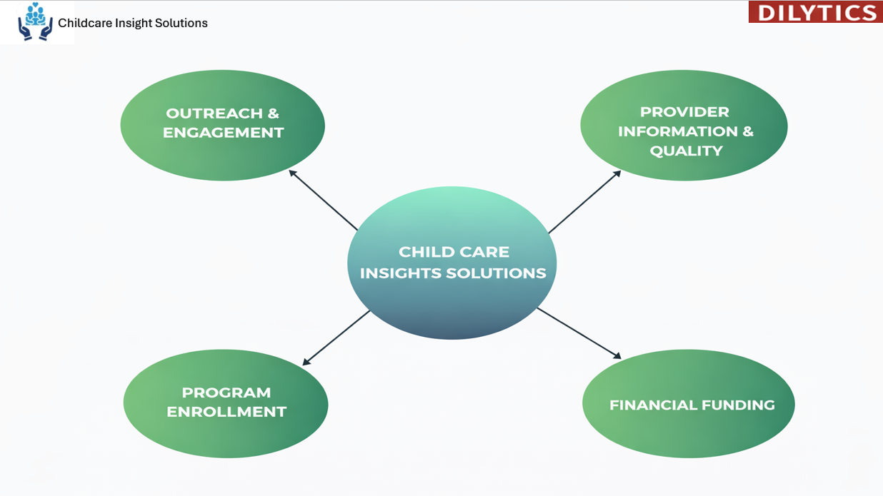
SOLUTION

Slide 5
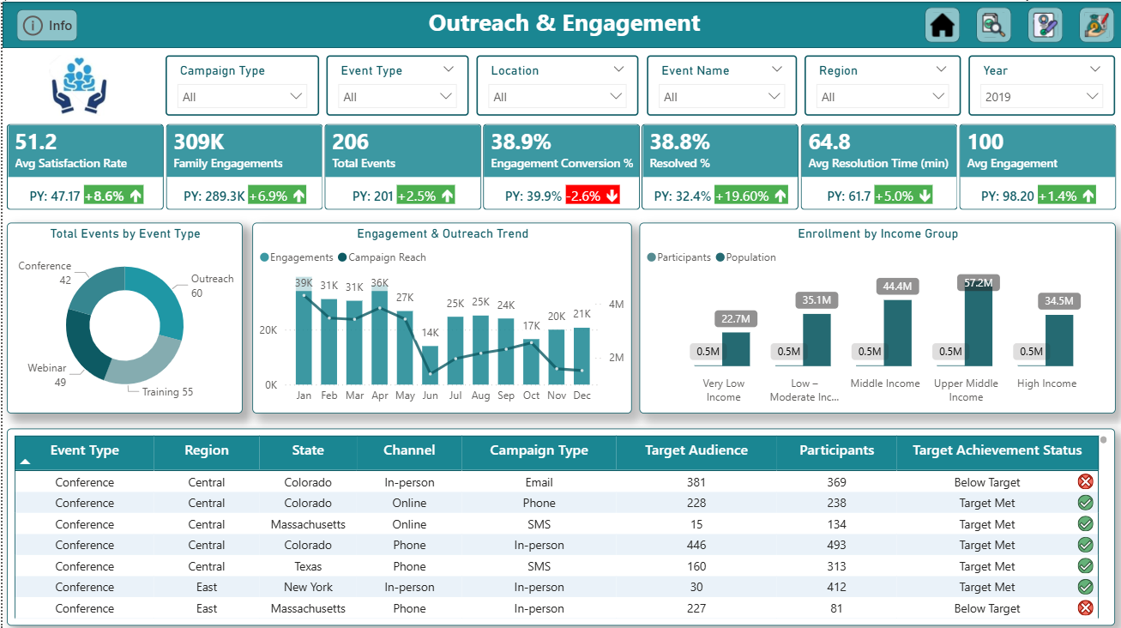
Childcare Insight Solutions
OUTREACH & ENGAGEMENT
Key Highlights
Tracks family engagement across webinars, trainings, conferences, and community events.
Monitors engagement effectiveness, satisfaction, conversions, resolutions, and event outcomes with YoY comparison.
Interactive Analysis: Enables drill-down by campaign, event type, location, region, and year.
Trend & Impact Insights: Highlights outreach performance, engagement trends, and enrollment patterns across income groups.

Slide 6
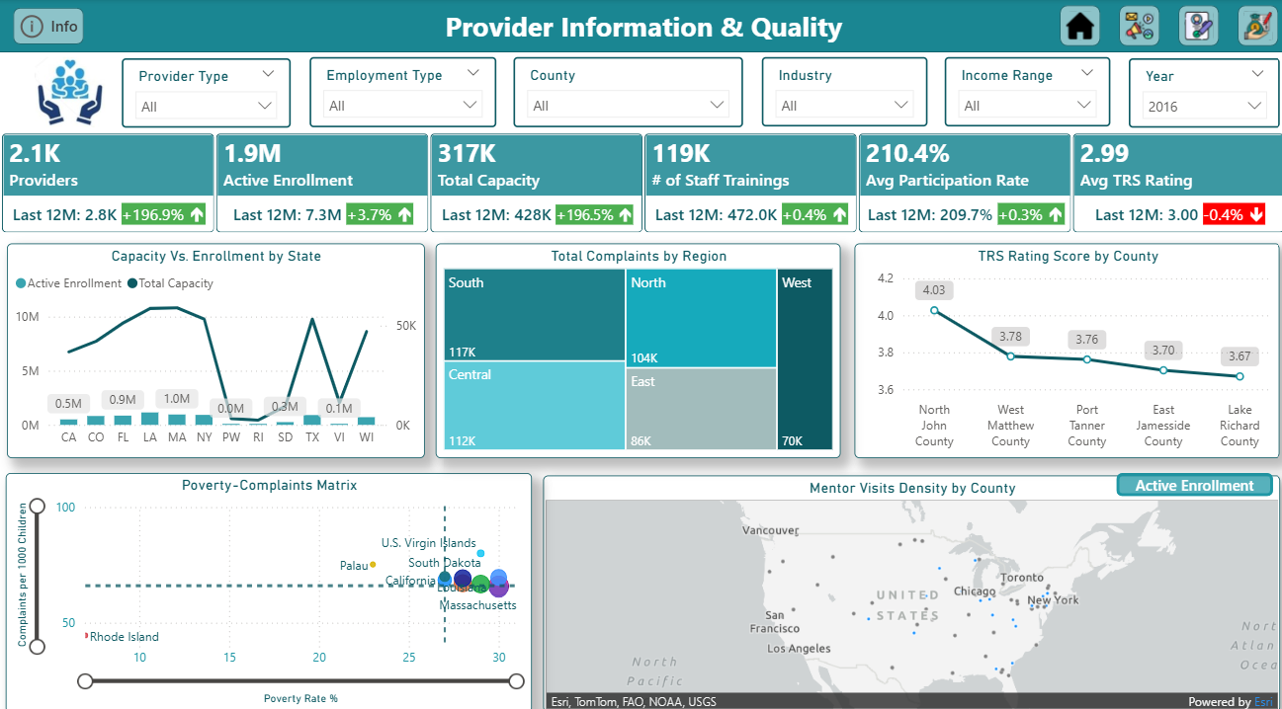
Childcare Insight Solutions
PROVIDER INFORMATION & QUALITY
Key Highlights
Unified view of childcare providers covering capacity, enrollment, quality, training, and compliance.
Key metrics tracked are providers, enrollment, capacity, staff training, and TRS ratings.
Interactive analysis by provider type, location, income range, and year.
Supports quality monitoring and policy decisions through performance and compliance insights

Slide 7
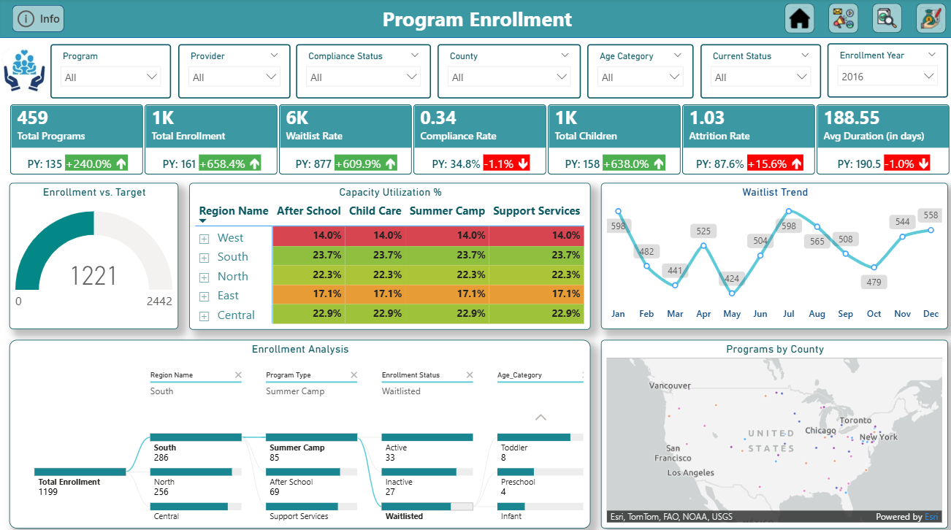
Childcare Insight Solutions
PROGRAM ENROLLEMENT
Key Highlights
Monitors program enrollment, capacity, waitlists, compliance, and attrition.
Tracks key enrollment and performance metrics across programs.
Enables filtered analysis by program, provider, location, age group, and year.
Identifies capacity gaps and trends for better planning and access.

Slide 8
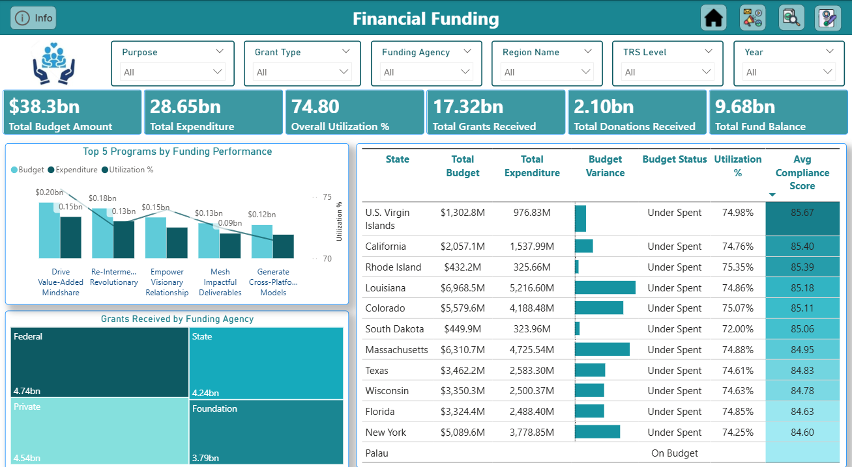
Childcare Insight Solutions
FINANCIAL FUNDING
Key Highlights
Tracks funding allocation, utilization, and financial performance.
Monitors key metrics like budget, spend, grants, donations, and balance.
Enables filtered financial analysis by agency, region, purpose, and year.
Supports oversight and funding optimization.

Slide 9
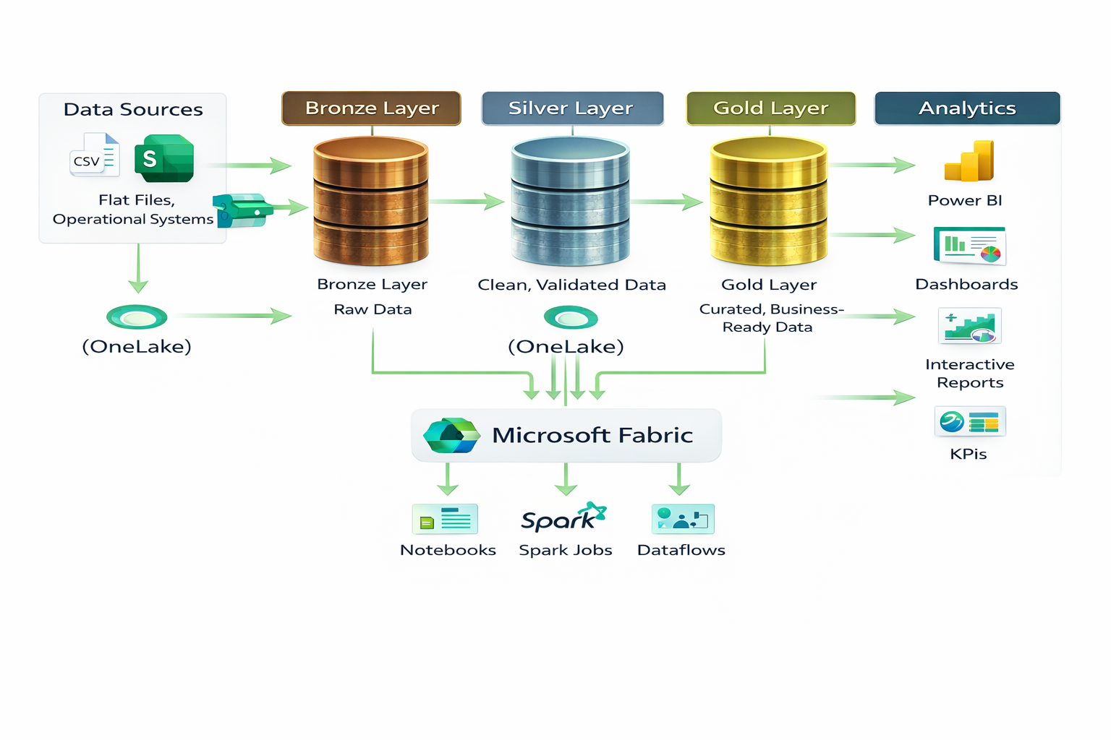
Childcare Insight Solutions
HIGH LEVEL ARCHITECTURE
Multiple data sources including flat files, operational systems, and external feeds
Bronze Layer (Raw Data)
Stores source data in its original format
Enables traceability and reprocessing when needed
Silver Layer (Clean & Validated Data)
Data cleansing, standardization, and validation applied
Ensures data quality, consistency, and business rules
Gold Layer (Business-Ready Data)
Curated and aggregated datasets optimized for analytics
Supports KPIs, dashboards, and reporting use cases
Unified storage with OneLake for centralized data access
Built on Microsoft Fabric using Spark notebooks, Spark jobs, and Dataflows
Seamless analytics consumption via Power BI dashboards, reports, and KPIs
Scalable and future-ready design to onboard new data sources and analytics needs

Slide 10
Childcare Insight Solutions
CONCLUSION
This platform delivers a purpose-driven, secure, and scalable analytics solution for child healthcare programs and is ready for implementation. It provides real-time visibility into enrollment, capacity, funding, and service utilization through an integrated data ecosystem connecting providers, funding partners, and outreach agencies.
Key Highlights:
4 interactive dashboards for quick and clear insights
17 comprehensive reports supporting detailed analysis
3-layer data architecture ensuring reliability and performance
178 standardized metrics for consistent and trusted reporting
Audit-ready and secure insights for compliance and governance, Future-ready design that supports new data sources, growth, and evolving business needs
NEXT STEP: AI IMPLEMENTATION

Slide 11

THANK YOU

